Slide 1
2026
ISTAP Initiatives and Sponsorship Opportunities

Slide 2
About ISTAP
The International Skin Tear Advisory Panel (ISTAP) was founded in 2011 and raises global awareness of skin tear prediction, assessment, prevention, and management through a multidisciplinary panel of healthcare professionals worldwide, representing Africa, Asia, Australia, Europe, Middle East, Latin America, and North America. Our mission is to improve outcomes for individuals at risk of or experiencing skin tears through education, research, and advocacy, all aimed at achieving our vision of "a world without skin tears". ISTAP has over 5,000 members worldwide.
Our Mission
Why are we needed?
ISTAP is a global inter-professional collaboration dedicated to improving skin tear prevention and management for everyone across the continuum of care. ISTAP seeks to achieve this through facilitation of evidence-based practice, education, research & advocacy.
Skin Tears: An Often Painful But Largely Preventable Health Care Issue.
Skin tears affect all ages and continue to be a common problem in all health care settings. They are often painful, acute wounds resulting from trauma to the skin, and are largely preventable.
Learn More
www.skintears.org/about
2

Slide 3
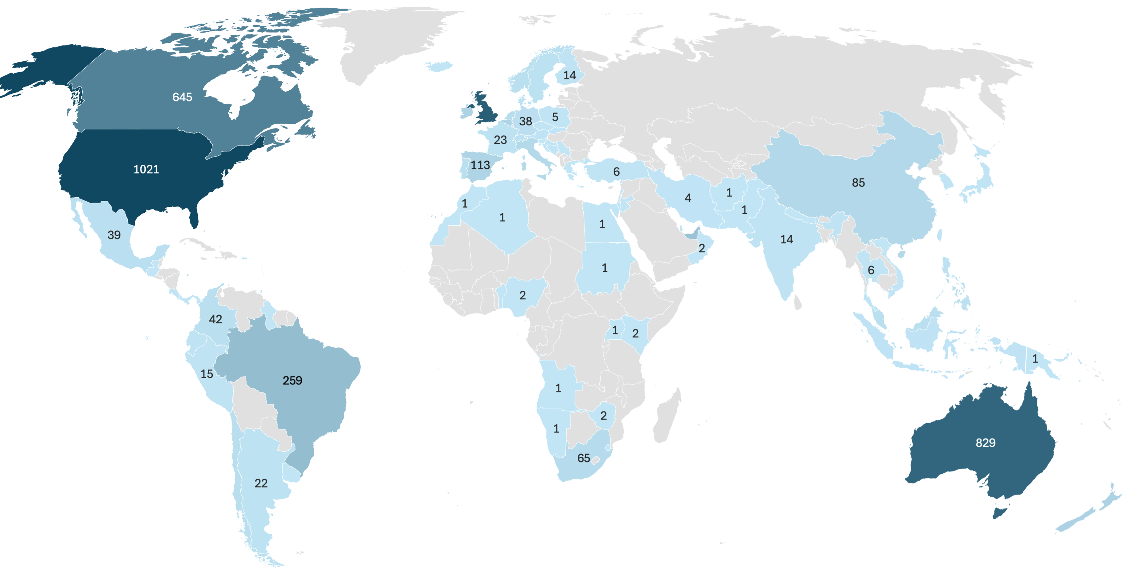
ISTAP Members by Country
January 21, 2026 (5,513 Total Members)
3

Slide 4
ISTAP Members: Top 20 Countries
January 21, 2026 (5,513 Total Members)
Rank | Country | Count | % | Rank | Country | Count | %
1 | United States | 1021 | 18.5% | 11 | China | 85 | 1.5%
2 | United Kingdom | 875 | 15.9% | 12 | Italy | 74 | 1.3%
3 | Australia | 829 | 15.0% | 13 | Saudi Arabia | 65 | 1.2%
4 | Canada | 645 | 11.7% | 14 | South Africa | 65 | 1.2%
5 | Brazil | 259 | 4.7% | 15 | Netherlands | 61 | 1.1%
6 | United Arab Emirates | 223 | 4.0% | 16 | Chile | 50 | 0.9%
7 | Ireland | 123 | 2.2% | 17 | Malaysia | 43 | 0.8%
8 | New Zealand | 122 | 2.2% | 18 | Colombia | 42 | 0.8%
9 | Spain | 113 | 2.0% | 19 | Norway | 40 | 0.7%
10 | Belgium | 109 | 2.0% | 20 | Portugal | 40 | 0.7%

Slide 5

Social Media Followers (4,483)
Jan 01 - Dec 31, 2025
The number of people who follow our Facebook, LinkedIn and Twitter (X) Pages or accounts.

Slide 6
Post impressions
Jan 01 - Dec 31, 2025
The number of times posts on our Facebook, LinkedIn and Twitter (X) Pages or accounts appeared on someone’s screen.

Slide 7
Our Reach – Website 2025
Jan 01 - Dec 31, 2025
Top Performing Pages (page views)
Site Sessions
1
6
Home
23,658
Join ISTAP
3,253
33,787
2
Resources
7
Articles & Publications
13,293
1,567
Unique Visitors
3
WWSTD 2025
4,677
8
BPR “Made Easy” Post
1,217
22,727
4
9
About ISTAP
New BPR Post
3,904
927
Page Views
5
Webinar Series
2,899
10
Search
772
65,803
7

Slide 8
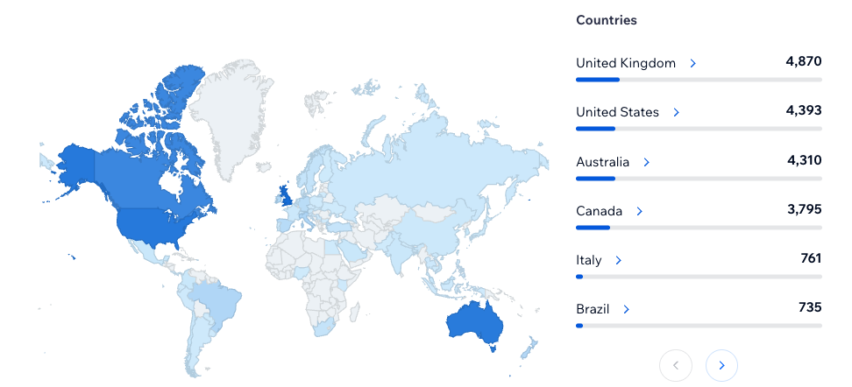
Sessions by Country

Slide 9
EWMA-ISTAP project: Living with Skin Frailty and Skin Tears Project : Video/Digital Story telling
Project #1
9

Slide 10
Objectives:
Establish a partnership between ISTAP and EWMA to highlight skin fragility and skin tear prevention and management through a multi-faceted, inter-professional, and widely communicated approach.
Develop solutions through collaboration among professionals, organizations, industry, the public, and patients and their families, capturing valuable experiences, perspectives, and expertise through video and digital storytelling.
Project Deliverables
EWMA, ISTAP, and industry partners will work together to achieve the following:
Project Design and Development: Develop a comprehensive project plan.
Digital Resources: Create and design a versatile suite of digital educational resources.
Produce materials that can be tailored for various purposes.
Dissemination: Launch an awareness campaign on ISTAP and EWMA social media channels.
Measure Impact: Implement measures to evaluate the project's impact.
10
Notes:
Objectives
Establish a partnership between ISTAP and EWMA to highlight skin fragility and skin tear prevention and management through a multi-faceted, inter-professional, and widely communicated approach.
Develop solutions through collaboration among professionals, organizations, industry, the public, and patients and their families, capturing valuable experiences, perspectives, and expertise through video and digital storytelling.
Project Deliverables
EWMA, ISTAP, and industry partners will work together to achieve the following:
Project Design and Development:
Create a comprehensive project plan.
Digital Resources:
Design and develop a suite of digital resources for educational purposes.
Create a range of materials that can be combined in various ways for different purposes.
Dissemination:
Distribute educational materials through an awareness campaign on ISTAP and EWMA social media channels.
Impact Measurement:
Devise measures to determine the project's impact.

Slide 11
Benefits of Sponsorship
How to Get Involved:
Please contact the EWMA Secretariat: Julie Bjerregaard
Phone: +45 70 20 03 05 Email: jb@ewma.org
Boost Brand Visibility:
Promote your company and products through campaign materials and events, showcasing your involvement in critical initiatives.
Network with Experts:
Develop valuable contacts with healthcare professionals across various specialties, enhancing your industry connections.
Global Recognition:
Gain international exposure by having your company logo prominently featured in campaign materials, reaching healthcare professionals worldwide.
Prestigious Acknowledgment:
Be recognized as a key supporter of this vital project on both the ISTAP and EWMA websites, cementing your reputation in the industry.
11
Notes:
Benefits of Sponsorship
Companies with products relevant to the treatment of skin tears will benefit from the project’s objectives to increase awareness and improve healthcare professionals’ skills in treating skin tears. Industry supporters will have the opportunity to:
Promote campaign materials and events, as well as the company’s involvement in these initiatives.
Develop contacts with healthcare professionals across various specialties involved in this topic.
Be acknowledged in campaign materials as sponsors, with approved use of the company logo visible to healthcare professionals internationally.
Be recognized as a supporter of this project on the ISTAP and EWMA websites.
Sponsorship Opportunity – How to Get Involved
To participate as a sponsor, please contact the EWMA Secretariat:
Contact Person: Julie Bjerregaard
Phone: +45 70 20 03 05
Fax: +45 70 20 03 15
Email: ewma@ewma.org
Direct Email: jb@ewma.org

Slide 12
World Without Skin Tears Day: International, Virtual Education Event | 9 April 2026
Project #2
12

Slide 13
Objective:
Deliver a virtual educational event to support evidence-based prevention and management of skin tears, showcasing current best practices from global experts.
Project Description:
Event Date: ISTAP World Without Skin Tears Day on 9 April 2026
Event Time: 9:00 AM - 12:00 PM Eastern Time
Format & Content: International virtual education event featuring global experts in skin tear prevention and management. Presentation of the new ISTAP Best Practice Guidelines.
Participation: Projected attendance of 1,500+ participants
13
Notes:
Objectives
Establish a partnership between ISTAP and EWMA to highlight skin fragility and skin tear prevention and management through a multi-faceted, inter-professional, and widely communicated approach.
Develop solutions through collaboration among professionals, organizations, industry, the public, and patients and their families, capturing valuable experiences, perspectives, and expertise through video and digital storytelling.
Project Deliverables
EWMA, ISTAP, and industry partners will work together to achieve the following:
Project Design and Development:
Create a comprehensive project plan.
Digital Resources:
Design and develop a suite of digital resources for educational purposes.
Create a range of materials that can be combined in various ways for different purposes.
Dissemination:
Distribute educational materials through an awareness campaign on ISTAP and EWMA social media channels.
Impact Measurement:
Devise measures to determine the project's impact.

Slide 14
Benefits of Sponsorship
How to Get Involved:
1,000 in the currency of your country
Email info@skintears.org
Gain visibility as a sponsor in all promotional materials, incl. the ISTAP website & communications to all ISTAP Members.
Prominent Recognition & Social Media Exposure:
Highlighted as a sponsor in ISTAP social media campaign on LinkedIn, Facebook, and X leading up to the event.
Event Visibility:
Featured on a prominent slide during the opening of the virtual event.
Commitment to Excellence & Global Brand Recognition:
Showcase your dedication to improving skin tear prevention and management strategies on an international scale.
Co-Promotion Opportunities:
Partner with your customers to co-promote this event; demonstrate your support for better skin tear outcomes.
Enhance your company's brand recognition and reputation internationally.
14
Notes:
Benefits of Sponsorship
Recognition as a sponsor of this event in all promotional material – on ISTAP website and communications to all ISTAP members
Recognition as a sponsor in an ISTAP social media campaign leading up to the event (Linkedin, Instagram, Facebook and X)
Your company will be recognized on a slide at the opening of this virtual event
Demonstrates your company ‘s commitment for improving skin tear prevention and management strategies internationally
Opportunity to co –promote this day with your customers demonstrating your support to improve skin tear outcomes
Build company and brand recognition internationally

Slide 15
All Skin Tones Skin Tear Classification Tool Project
Project #3
A copy of the original classification tool can be found online at: www.skintears.org/resources#classification
15

Slide 16
Part 1: Develop a culturally safe ISTAP Skin Tear Classification Tool for all skin tones
Key members of the ISTAP Board will validate the classification of skin tear pictures of different skin tones against the original tool
Collaborate with nurses in all communities and different peoples to obtain photos of skin tears in all skin tones that reflect the diversity of humanity and correspond to the ISTAP Skin Tear Classification Tool
Methodology
Objective:
To provide a culturally safe ISTAP Skin Tear Classification Tool based on the existing validated ISTAP Skin Tear Classification that reflects all skin tones
A copy of the original classification tool can be found online at: www.skintears.org/resources#classification
16
Notes:
Objective
To provide a culturally safe ISTAP Skin Tear Classification Tool based on the existing validated ISTAP Skin Tear Classification Tool that is focused on Indigenous skin tones
Methodology:
Work with nurses in Indigenous communities in order to obtain photos of skin tears in Indigenous Skin Tones that match the classification images in the Skin Tear Classification Tool in order to make in order to make this classification tool culturally appropriate. Once the images have been obtained, key members from the International Skin Tear Advisory Panel Board of Directors will conduct a validation process to ensure that the Indigenous skin tear photos are the same classification as the images in the original classification tool. A new tool will be developed in conjunction with the NSWOCC Indigenous Core program members in order to ensure that it is culturally safe and relevant to Indigenous people. A copy of the original classification tool can be found here:
https://www.skintears.org/_files/ugd/9d080f_769978c85b0c4020930038056df09658.pdf?index=true

Slide 17
Benefits of Sponsorship
How to Get Involved:
CAD $1,000
Email Troy Curtis at office@nswoc.ca
Premier Recognition:
Be prominently acknowledged as a sponsor of this culturally safe skin tear classification tool for people with darker skin tones.
Showcase Commitment:
Highlight your company's dedication to advancing skin tear prevention and management strategies for people of all skin tones
Strengthen Reputation:
Enhance your company's brand recognition and credibility.
17
Notes:
Benefits of Sponsorship
Recognition as a sponsor of this new classification tool that is culturally safe for Indigenous people.
Your company support shows your commitment to improving skin tear prevention and management strategies in Indigenous communities.
Build company and brand recognition in Indigenous communities.
Sponsorship Opportunity – how to get involved
$1,000 CDN
E Mail Cathy Harley and Troy Curtis at office@nswoc.ca

Slide 18
Part 2: Indigenous Populations in Canada and beyond: Skin Tear Classification Tool Project
Once images are received, key members of the ISTAP Board will validate the classification of skin tear pictures of different indigenous skin tones against the original tool
Work with key partners, including nurses in indigenous communities across Canada, to obtain photos of skin tears in Indigenous skin that match the classification images in the ISTAP Skin Tear Classification Tool.
Methodology
A new tool will be developed in conjunction with the NSWOCC Indigenous Health Core Program members to ensure that it is culturally safe and relevant to Indigenous people.
Objective:
To provide a culturally safe ISTAP Skin Tear Classification Tool based on the existing validated ISTAP Skin Tear Classification Tool that reflects all skin tones in indigenous populations in Canada.
A copy of the original classification tool can be found online at: www.skintears.org/resources#classification
18
Notes:
Objective
To provide a culturally safe ISTAP Skin Tear Classification Tool based on the existing validated ISTAP Skin Tear Classification Tool that is focused on Indigenous skin tones
Methodology:
Work with nurses in Indigenous communities in order to obtain photos of skin tears in Indigenous Skin Tones that match the classification images in the Skin Tear Classification Tool in order to make in order to make this classification tool culturally appropriate. Once the images have been obtained, key members from the International Skin Tear Advisory Panel Board of Directors will conduct a validation process to ensure that the Indigenous skin tear photos are the same classification as the images in the original classification tool. A new tool will be developed in conjunction with the NSWOCC Indigenous Core program members in order to ensure that it is culturally safe and relevant to Indigenous people. A copy of the original classification tool can be found here:
https://www.skintears.org/_files/ugd/9d080f_769978c85b0c4020930038056df09658.pdf?index=true

Slide 19
Part 2 continued
Methodology
We will continue working with our International Official Partners, to share learning and insights gathered from the Canadian project, so they can be used as appropriate in their skin tear related work with local communities and peoples in an appropriate manner with due respect for their customs, practices and beliefs.
Collaborate with ISTAP International Official Partners to repeat the methodology from Phase 1 among Indigenous Populations in other countries.
Once images are received, key members of the ISTAP Board will validate the classification of skin tear pictures of different skin tones against the original tool.
Objective:
To provide a culturally safe ISTAP Skin Tear Classification Tool based on the existing validated ISTAP Skin Tear Classification Tool that reflects all skin tones in other indigenous populations globally.
A copy of the original classification tool can be found online at: www.skintears.org/resources#classification
19
Notes:
Benefits of Sponsorship
Recognition as a sponsor of this new classification tool that is culturally safe for Indigenous people.
Your company support shows your commitment to improving skin tear prevention and management strategies in Indigenous communities.
Build company and brand recognition in Indigenous communities.
Sponsorship Opportunity – how to get involved
$1,000 CDN
E Mail Cathy Harley and Troy Curtis at office@nswoc.ca

Slide 20
Annual Corporate Partnership Opportunity
Opportunity #4
20

Slide 21
Benefits of Sponsorship
How to Get Involved:
12,000 Euros per year
Email info@skintears.org
Recognized Corporate Partner:
Website Promotion:
Prominent Event Supporter:
Exclusive Photo Access:
Strategic Meetings:
Gain annual recognition as a corporate partner of ISTAP.
Have your company’s web link prominently displayed near skin tear education materials on the ISTAP website, highlighting your formal partnership and support.
Be acknowledged as a supporter of ISTAP's "World Without Skin Tears Day" through promotion on all event materials, social media campaigns, and the ISTAP website.
Obtain access to the ISTAP skin tear photo database for up to 25 photos with a nonexclusive, perpetual, royalty-free, irrevocable, worldwide license to use, copy, and distribute in connection with its educational programs.
Meet with the ISTAP Executive twice a year to discuss skin tear initiatives, research updates, and explore opportunities in the field.
21
Notes:
Sponsorship Benefits
Recognized Corporate Partner: Gain annual recognition as a corporate partner of ISTAP, showcasing your ongoing commitment.
Prominent Event Supporter: Be acknowledged as a supporter of ISTAP's "World Without Skin Tears Day" through promotion on all event materials, social media campaigns, and the ISTAP website.
Exclusive Photo Access: Obtain access to the ISTAP skin tear photo database with a nonexclusive, perpetual, royalty-free, irrevocable, worldwide license to use, copy, and distribute up to 25 photos for your educational programs.
Website Promotion: Have your company’s web link prominently displayed near skin tear education materials on the ISTAP website, highlighting your formal partnership and support.
Strategic Meetings: Meet with the ISTAP Executive twice a year to discuss skin tear initiatives, research updates, and explore opportunities in the field.
Cost: 12,000 Euros per year
Sponsorship Outcomes
Enhanced Visibility: Increase your company's visibility with clinicians making product decisions for skin tears.
Support Demonstration: Showcase your support for ISTAP and commitment to improving patient outcomes in skin tear prevention and management.
Educational Resource Access: Strengthen your company’s education and marketing efforts with access to the ISTAP photo library.
Direct Engagement: Provide clinicians and ISTAP members direct access to your company through a link on the skintears.org website.
Exclusive Insights: Gain one-on-one access to the ISTAP Executive and Board, staying at the forefront of skin tear research, education, and strategic approaches.

Slide 22
Outcomes:
Enhanced Visibility:
Increase your company's visibility with clinicians making product decisions for skin tears.
Support Demonstration:
Showcase your support for ISTAP and commitment to improving patient outcomes in skin tear prevention and management.
Educational Resource Access:
Strengthen your company’s education and marketing efforts with access to the ISTAP photo library.
Direct Engagement:
Provide clinicians and ISTAP members direct access to your company through a link on the skintears.org website.
Exclusive Insights:
Gain one-on-one access to the ISTAP Executive and Board, staying at the forefront of skin tear research, education, and strategic approaches.
22
Notes:
Objective
To provide a culturally safe ISTAP Skin Tear Classification Tool based on the existing validated ISTAP Skin Tear Classification Tool that is focused on Indigenous skin tones
Methodology:
Work with nurses in Indigenous communities in order to obtain photos of skin tears in Indigenous Skin Tones that match the classification images in the Skin Tear Classification Tool in order to make this classification tool culturally appropriate. Once the images have been obtained, key members from the International Skin Tear Advisory Panel Board of Directors will conduct a validation process to ensure that the Indigenous skin tear photos are the same classification as the images in the original classification tool. A new tool will be developed in conjunction with the NSWOCC Indigenous Core program members in order to ensure that it is culturally safe and relevant to Indigenous people. A copy of the original classification tool can be found here:
https://www.skintears.org/_files/ugd/9d080f_769978c85b0c4020930038056df09658.pdf?index=true

Slide 23
Thank you!
Be part of our vision:
A WORLD WITHOUT SKIN TEARS

